Slide 1
CoSpace
Presented by team BnY
Brandon Tjandra, Daniel Chen,
Dahyeon Park, Evan Haque,
Md Wasiul Islam

Slide 2
What’s CoSpace?
[CoSpace]: roommate-focused real estate app
What
Why
CoSpace is a real estate app that allows the user to put listings to get roommates for their house.
Rent is a huge problem in the United States.
CoSpace will allow for users to find roommates to make rent cheaper by splitting it.

Slide 3
How?
Sarah, a young professional,
is looking for a new roommate because managing the rent on her three-bedroom apartment has become too expensive on her own.
Sarah,
Request and Chat Feature
Potential roommates can send a chat to hosts to ensure compatibility.
Creating a Listing
Adding Reviews
A user can post a listing for their property.
After living with a host, users can leave feedback.

Slide 4
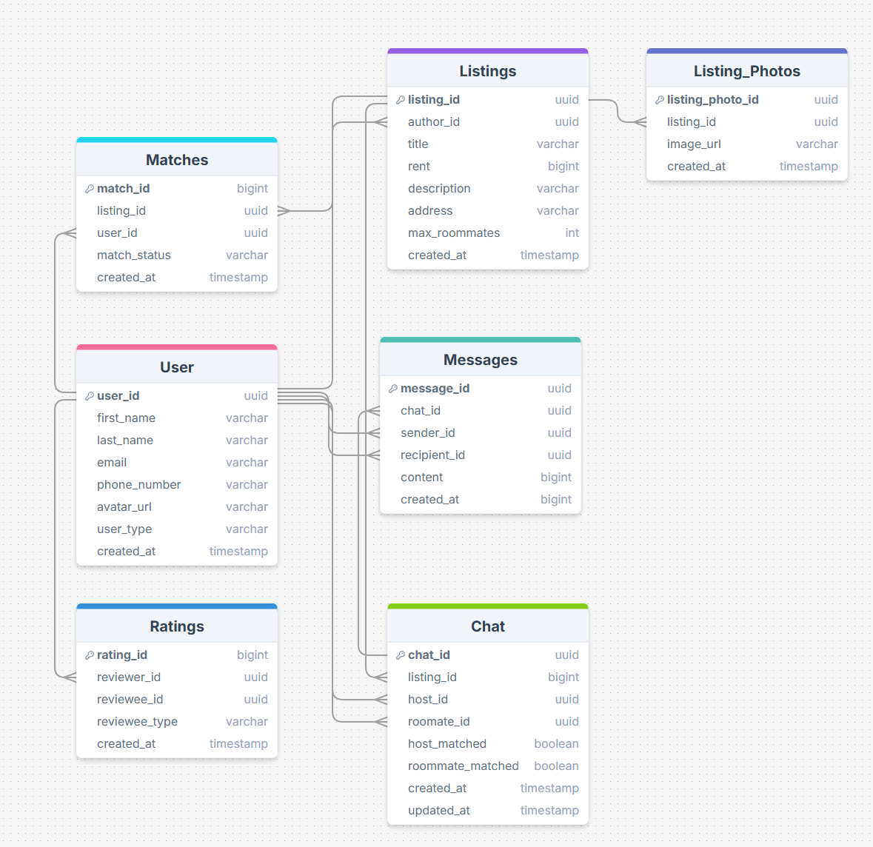
The Data

Slide 5
The Stack
Frontend
NextJS
Tailwindcss
Supabase
SQL database
DBMS
Backend
NodeJS
NextJS
Github
Git

Slide 6
Member Roles
A
B
F
C
Backend: Brandon, Md
Frontend: Evan, Dahyeon
PM: Daniel
E
D

